Slide 1
History of virtual reality
Cracow, 17.06.2018
Przemysław Kleszcz

Slide 2
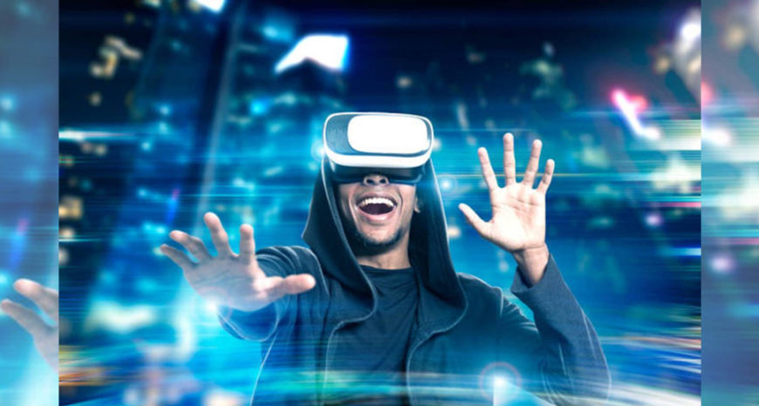
What is virtual reality? Three dimensional, computer generated environnment which can be explored and interacted with a person.

Slide 3
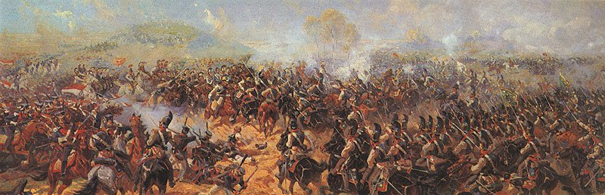
Early attempts Panoramic paintings

Slide 4
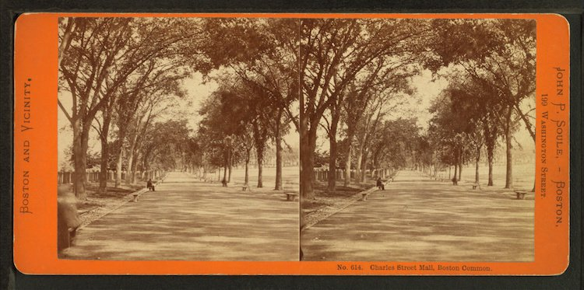
Stereoscopic photos and viewers 1838 - The stereoscope was born -Virtual tourism

Slide 5
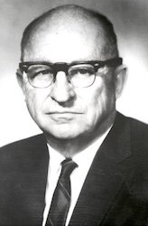
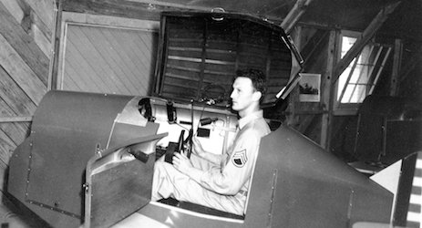
Link Trainer The First Flight Simulator 1929
Link Trainer Simulator
Edward Link

Slide 6
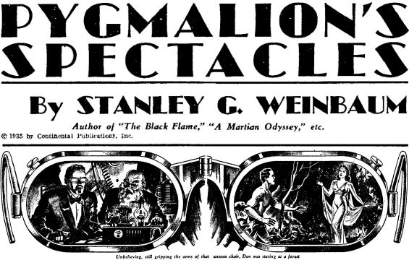
Science fiction story predicted VR 1930

Slide 7
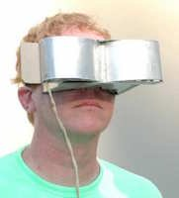
First VR Headset by Morton Heilig 1960 - Telesphere Mask - First ‚modern’ wearable googles

Slide 8
‚Virtual reality’ name was born 1987 - Jaron Lanier, founder of VPL popularised the term. - VPL developed a range of VR gear -EyePhone (9400$) -EyePhone HRX (49000$) -Dataglove(9000$)

Slide 9
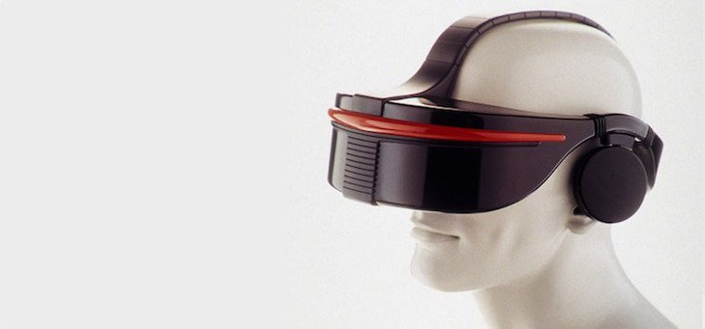
SEGA VR glasses 1993 - Head tracking -Stereo sound -LCD screens in the visor -Remained forever in the prototype phase

Slide 10
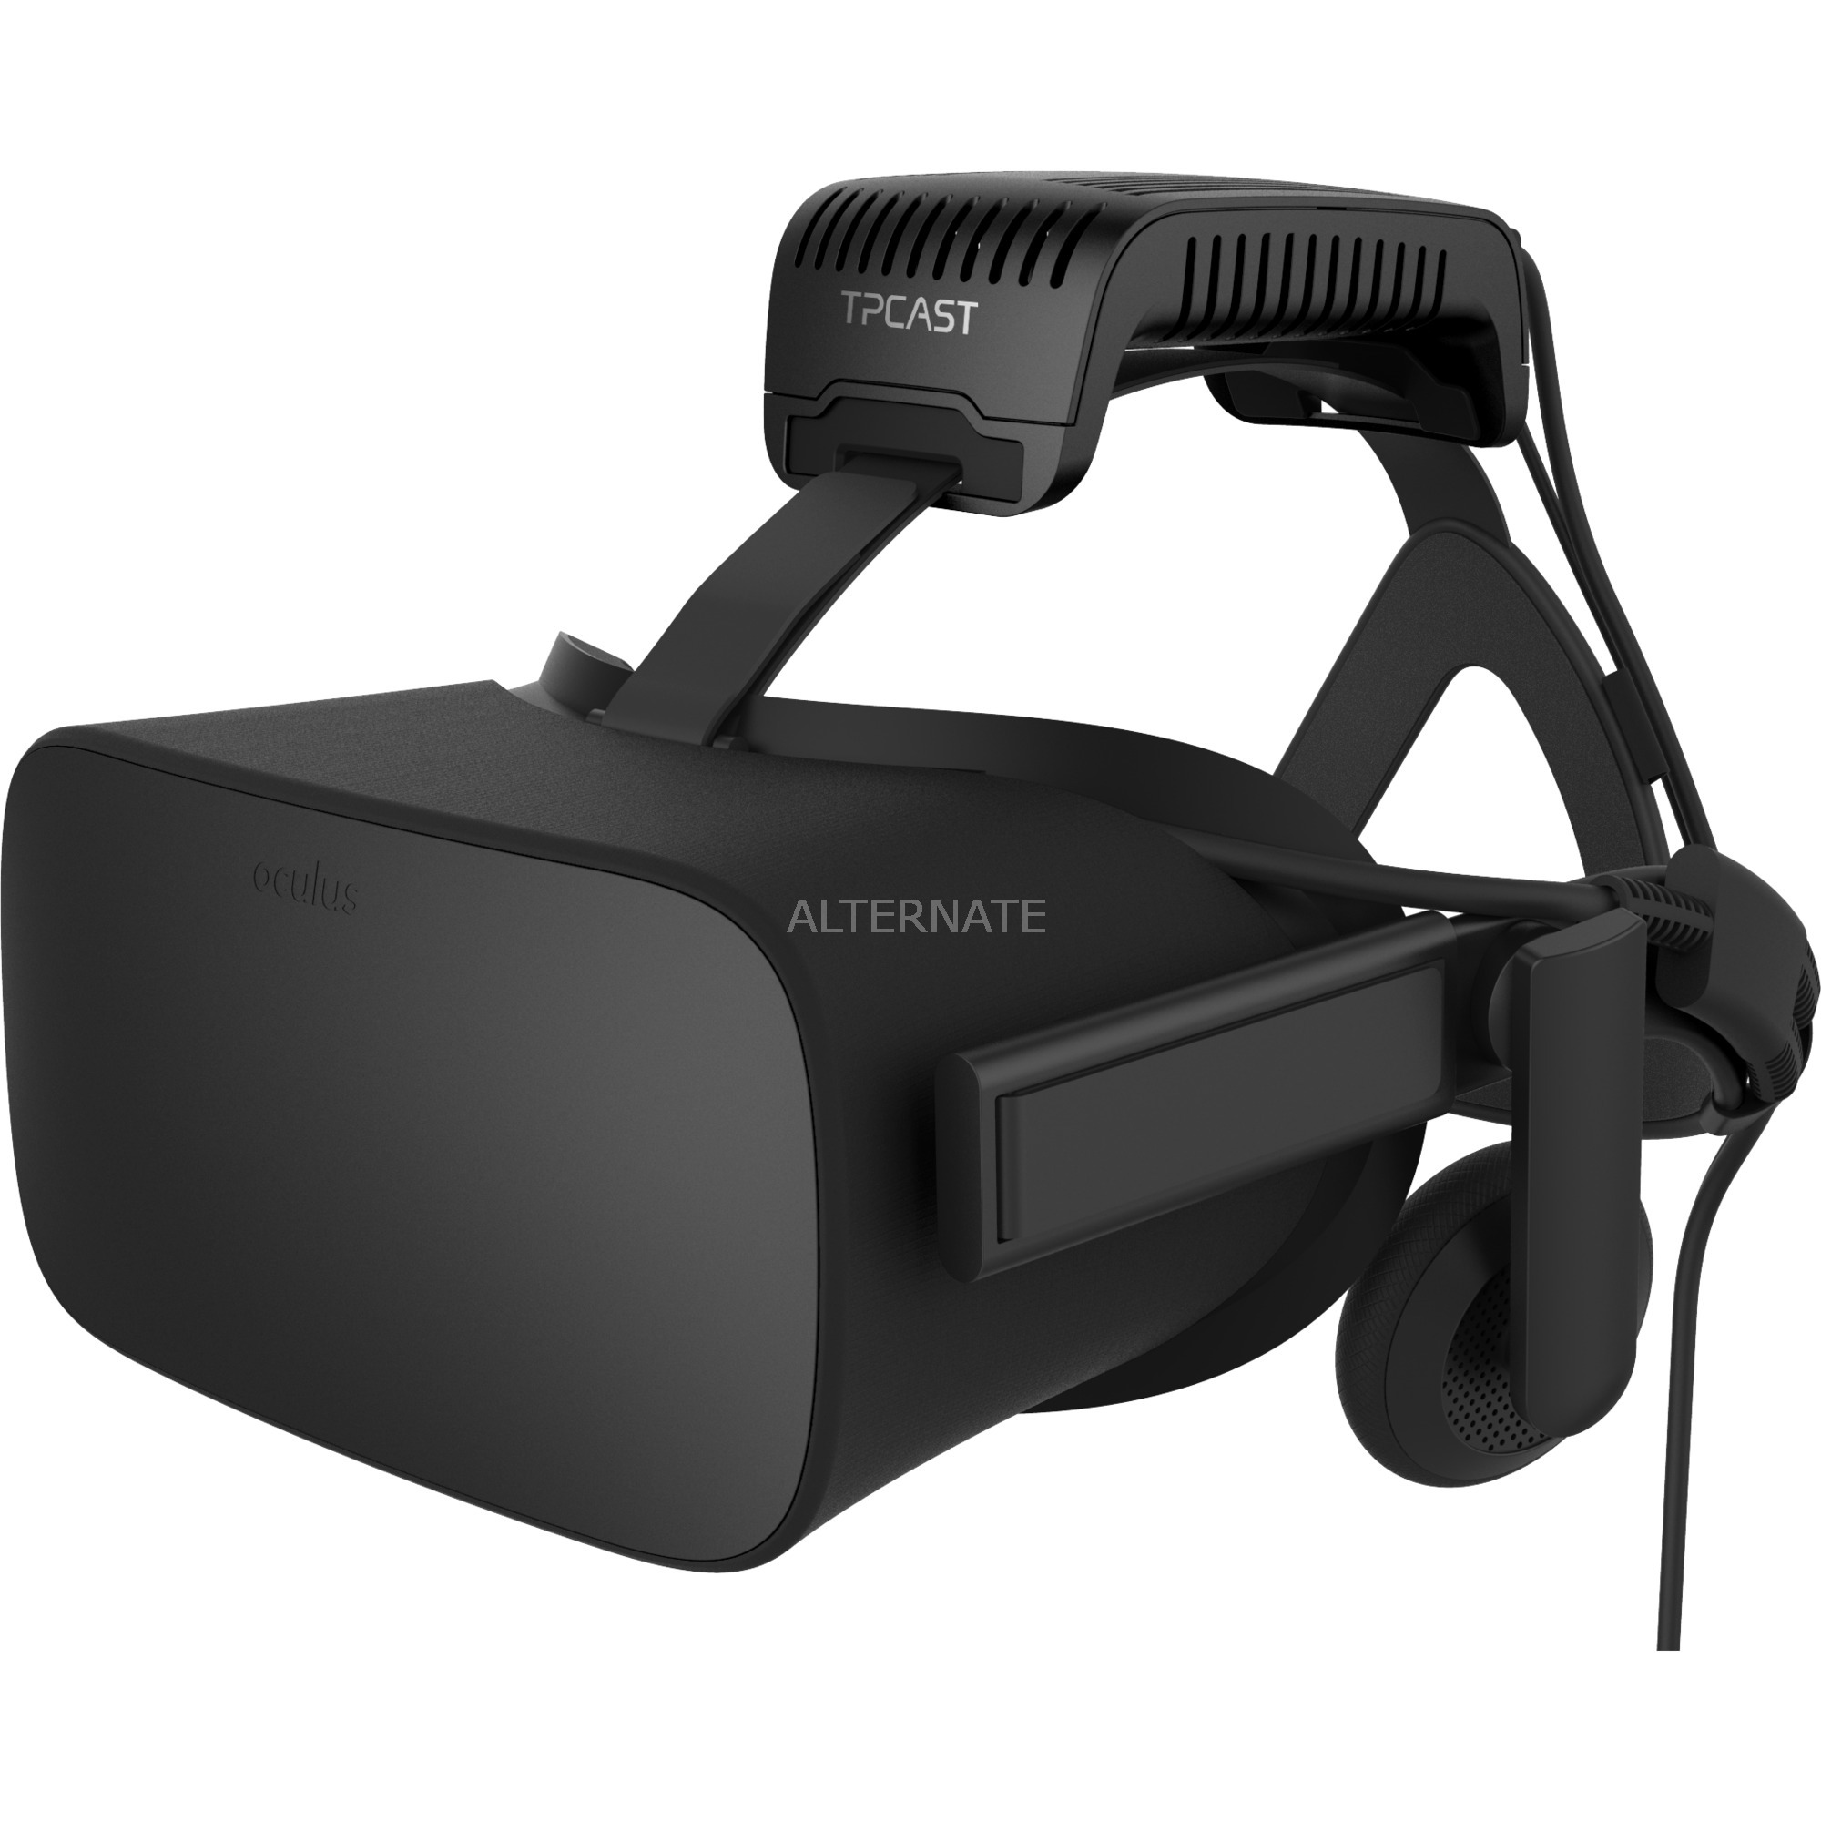
VR in the 21st century -Amazing computational power growth -Simple ‚smartphone based’ devices -Modern VR devices (Oculus Rift, HTC Vive)

Slide 11
Sincere thanks for your attention

